Slide 1
Clients Clusters for CRC Pets
Daniel Francisco Molina Molina

Slide 2
The Company
CRC Pets company that distributes pet accesories through veterinaries and pet shops.
Founded on late 2019.
Hired 3 sales reps for expansion during 2021.

Slide 3
The Problem
They don´t know how to distribute the sales represantives

Slide 4
The Solution
Create geographical clusters of potential clients

Slide 5
The Data
Data pulled from Foursquare API.
Variables used:
Name
Latitude
Longitude

Slide 6
Methodology
K-means methodology to create three clusters based on the latitude and longitude
To select the venues:
used the geographic location of San José, Costa Rica and looked for venues with names including either “Vet”, “Pet”, “Perro” or “Gato” in a radius of 5000.
In total it shows 142 results

Slide 7



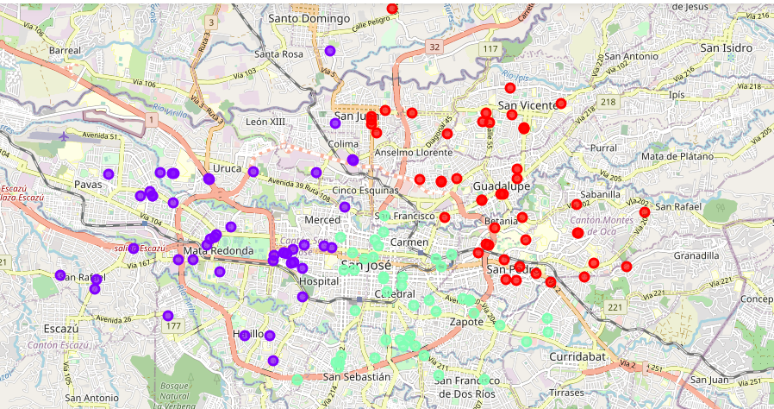
Results

Slide 8
Conclusion
There are 3 different clusters in the map.
Clusters namedas Northeast, Center-South and West.
Now CRC Pets has the geographical clusters for each of the sales representatives.

